Slide 1
Movie Script Analysis Harry Potter and the Goblet of Fire Utilizing Natural Language and Other Text Analysis Processing
LeBow College of Business at Drexel University, MIS 612
November 25, 2019
Group 4.1: Ravi Bhagwat, Hao Deng, Russell Destremps and Sahibzada Aasim Imtiyaz
Notes:
Russell

Slide 2
1. Business Case 2. Methodology 3. Findings and Insights 4. Model Refinement
Notes:
Russell

Slide 3
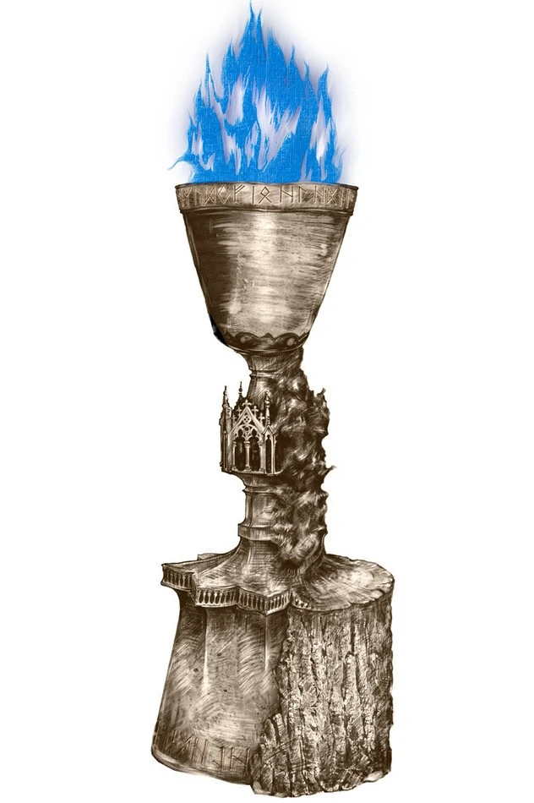
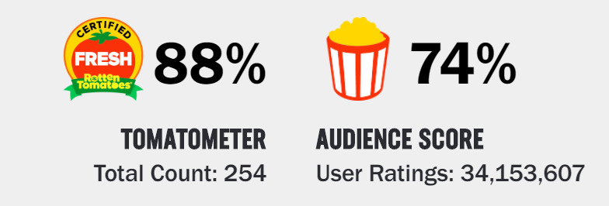
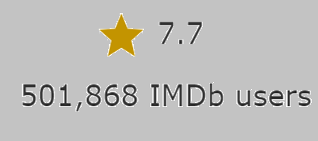
$103 Million
Opening Weekend
“It’s downright scary how good this move is.“
- Wall Street Journal
8th Highest Grossing Film of all Time.
$900 Million
Worldwide Sales
“The film…has purpose, shape and style…Goblet explores a wide emotional range. ”
- Roger Ebert
Highest grossing movie of 2005
$25 Billion Brand Value
https://harrypotter.fandom.com/wiki/Goblet_of_Fire
Notes:
Russell

Slide 4
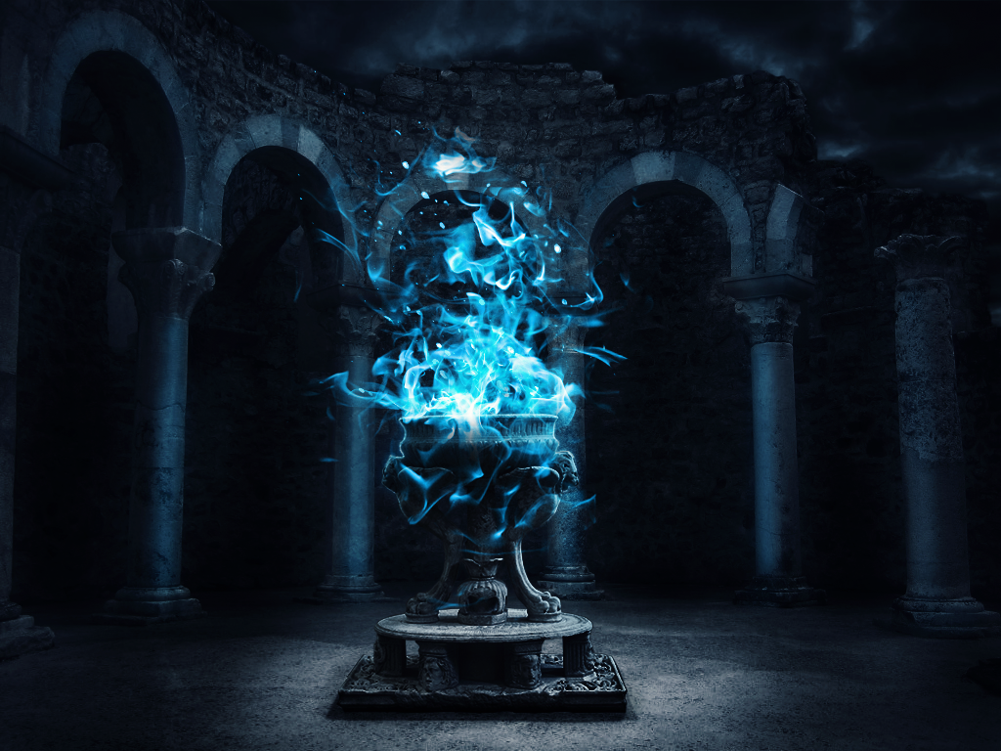
Harry Potter and the Goblet of Fire
Quidditch World Cup
Voldemort’s Return
Triwizard Tournament
Maze Challenge
Dragon Challenge
Yule Ball
Water Challenge
Notes:
Hao – The screenplay adapts most of the major events from the original book, Harry Potter and his companions went to Quidditch world cup at the beginning of the movie and that was the place where the followers of Lord Voldemort came out again to attack innocent ppl. Then Harry was forced to attend the Triwizard tournament because someone put his name into the goblet of fire. Within the Triwizard Tournament there were three challenges: Dragon challenge, which Participants had to defeat a dragon; Participants needed to save your friend that was trapped under water; and in the maze challenge participants had to find the key to win the entire tournament. That was the time when Harry witnesses Voldemort’s return and told everybody. Goblet of Fire is an important chapter for all series because Harry achieves one of his most important achievements in his life and sets the dark tone for the future chapters because the dark lord has returned.

Slide 5







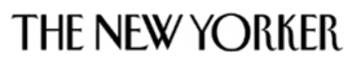


“…impressive emotional development…”
“Edge of your seat.”
“Mature.”
“Intense.”
“Fraught with conflict…”
“…engaging....”
“…balances delicately between whimsy and ominous…”
“…intelligent…”
“Quick Pace.”
“Dark.”
“…wide emotional range…”
“...quick pace...”
“Rich…full...”
https://www.metacritic.com/movie/harry-potter-and-the-goblet-of-fire/critic-reviews
Notes:
Hao – We also did the thematic analysis for 38 NA prominent critics from Metacritic.com. Here are overall themes about the movie. Mature, intense, dark, quick pace. By applying thematic analysis to the reviews, we are able to do exploratory analysis to our hypothesis and methodology, which Russell will talk about them for the next part.

Slide 6
1. Business Case 2. Methodology 3. Findings and Insights 4. Model Refinement
Notes:
Russell

Slide 7
50,000 → 150 → 75
Hypothesis
Utilizing historical data, a qualitative analytical model can be developed to screen and score movie scripts in order to accurately predict quantitative results of associated movie production and box office release.
https://stephenfollows.com/, https://theatlantic.com
Notes:
Russell

Slide 8
Movie
Script
Sentiment Analysis
Social Network Analysis
Other Natural Language Processing
Predictive Range of Movie Success
Notes:
Russell

Slide 9
1. Business Case 2. Methodology 3. Findings and Insights 4. Model Refinement

Slide 10
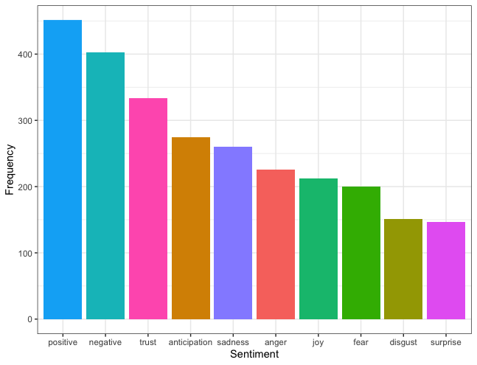
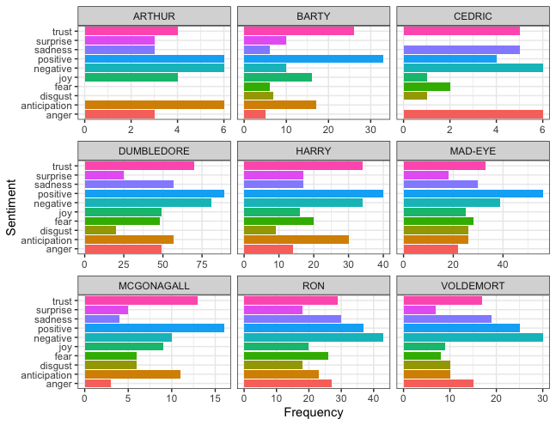
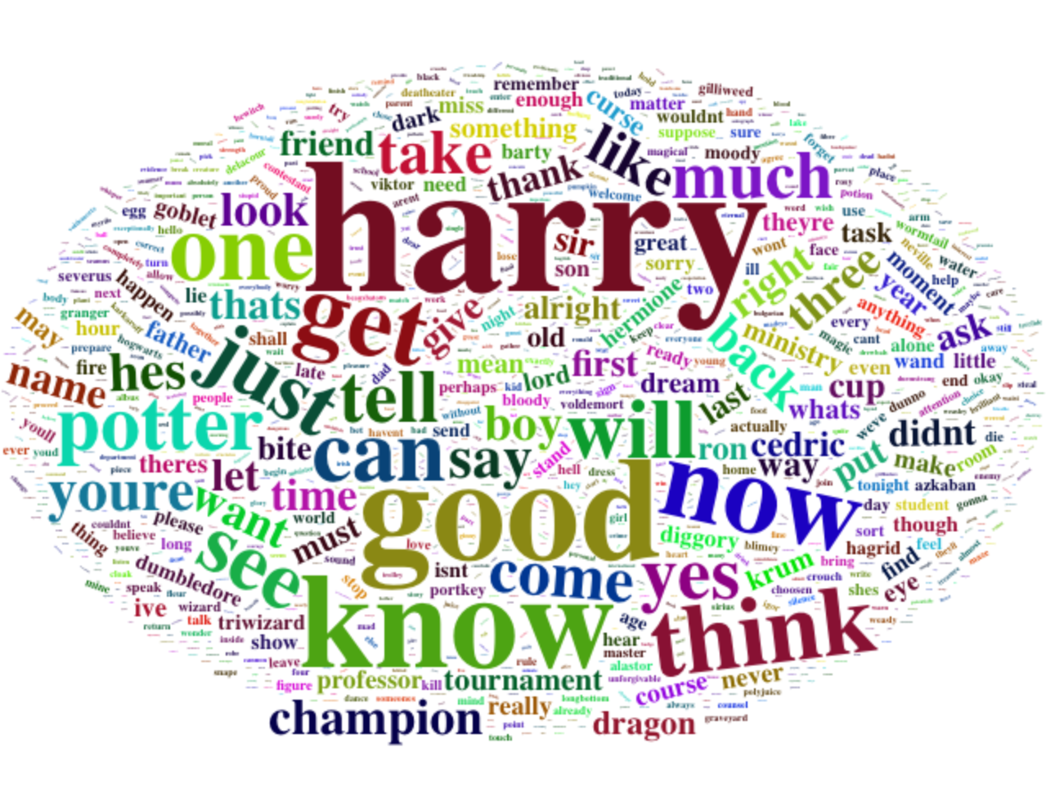

Slide 11
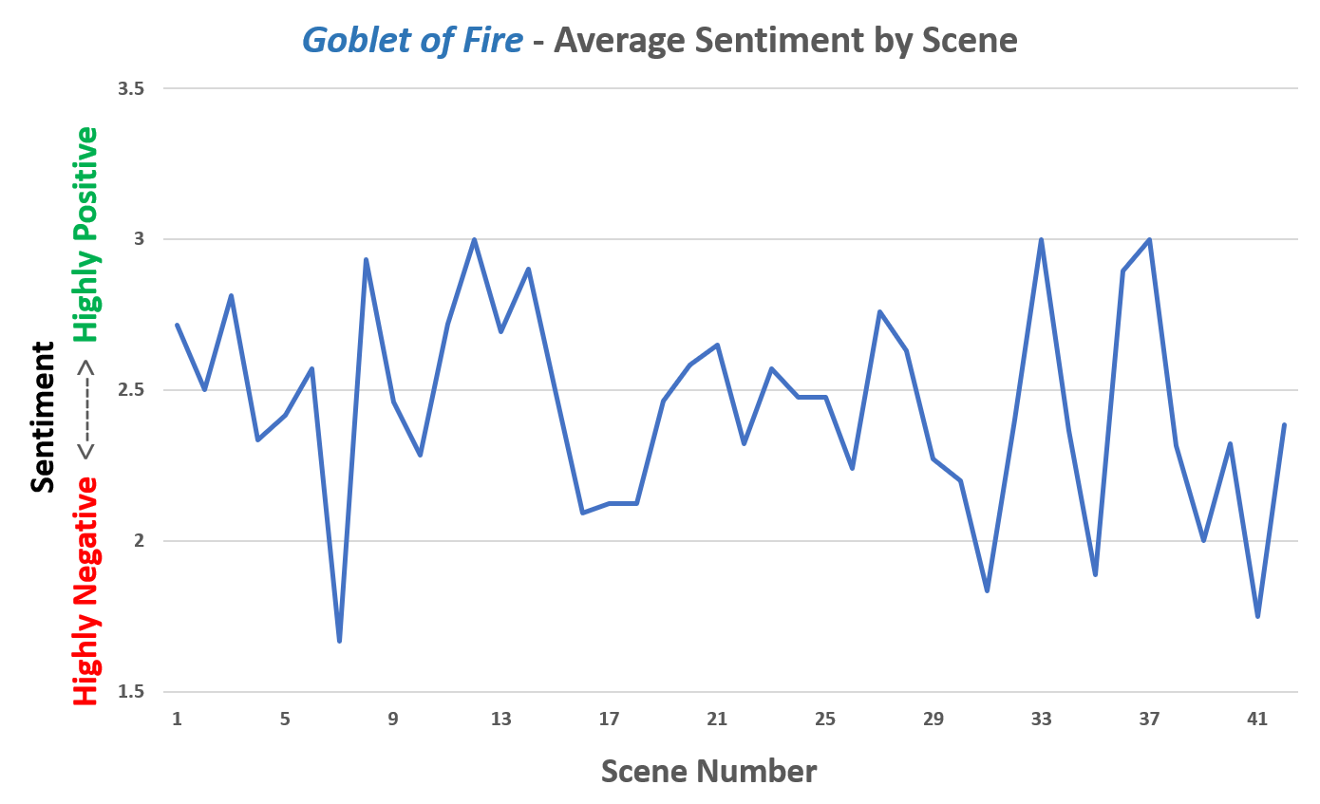

Slide 12
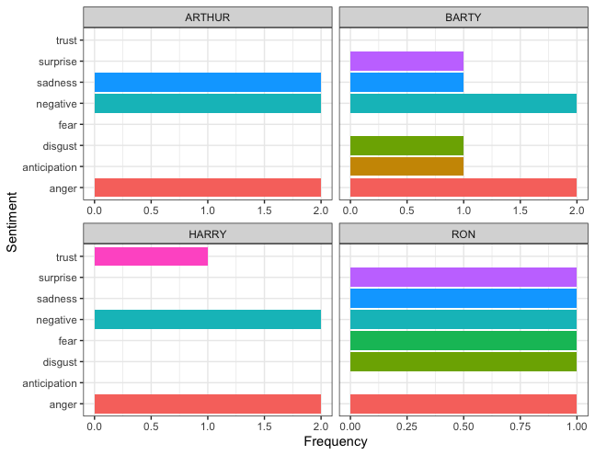
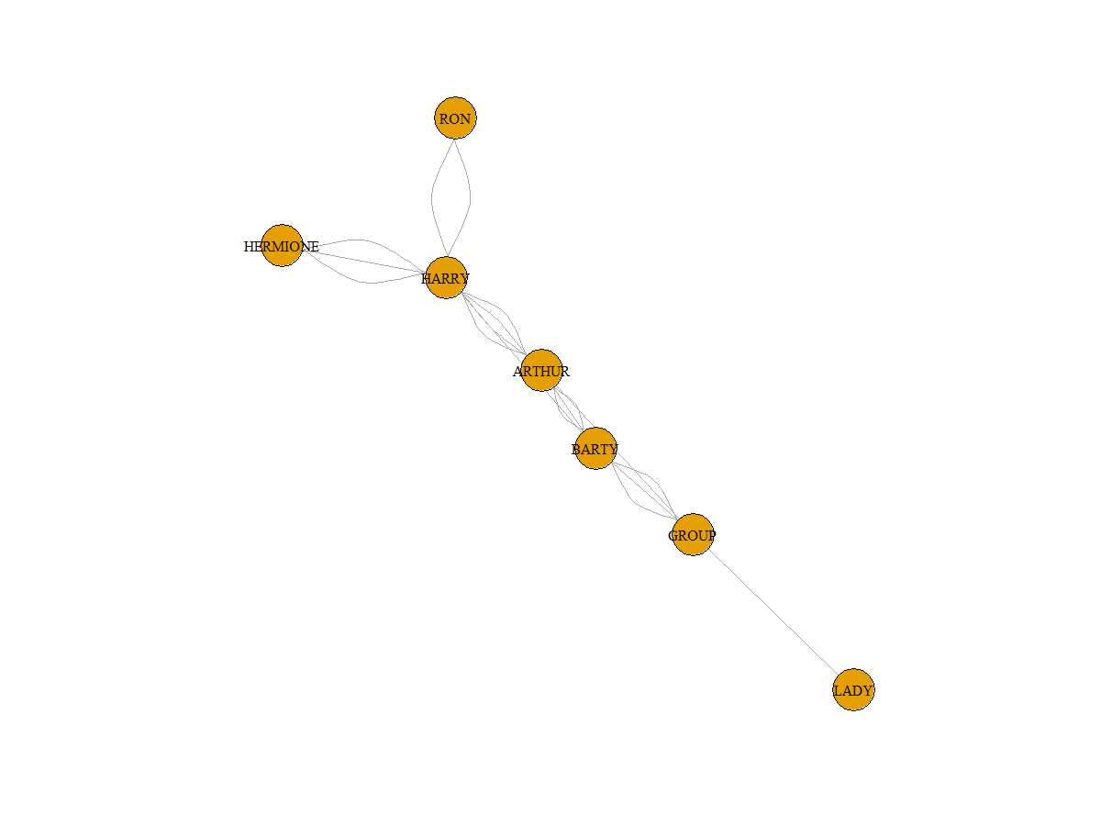
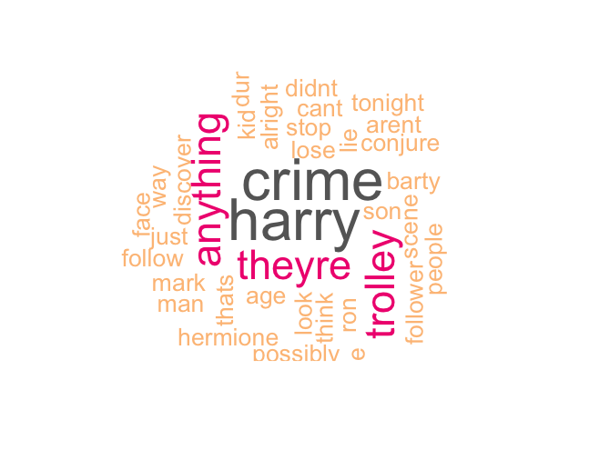

Slide 13
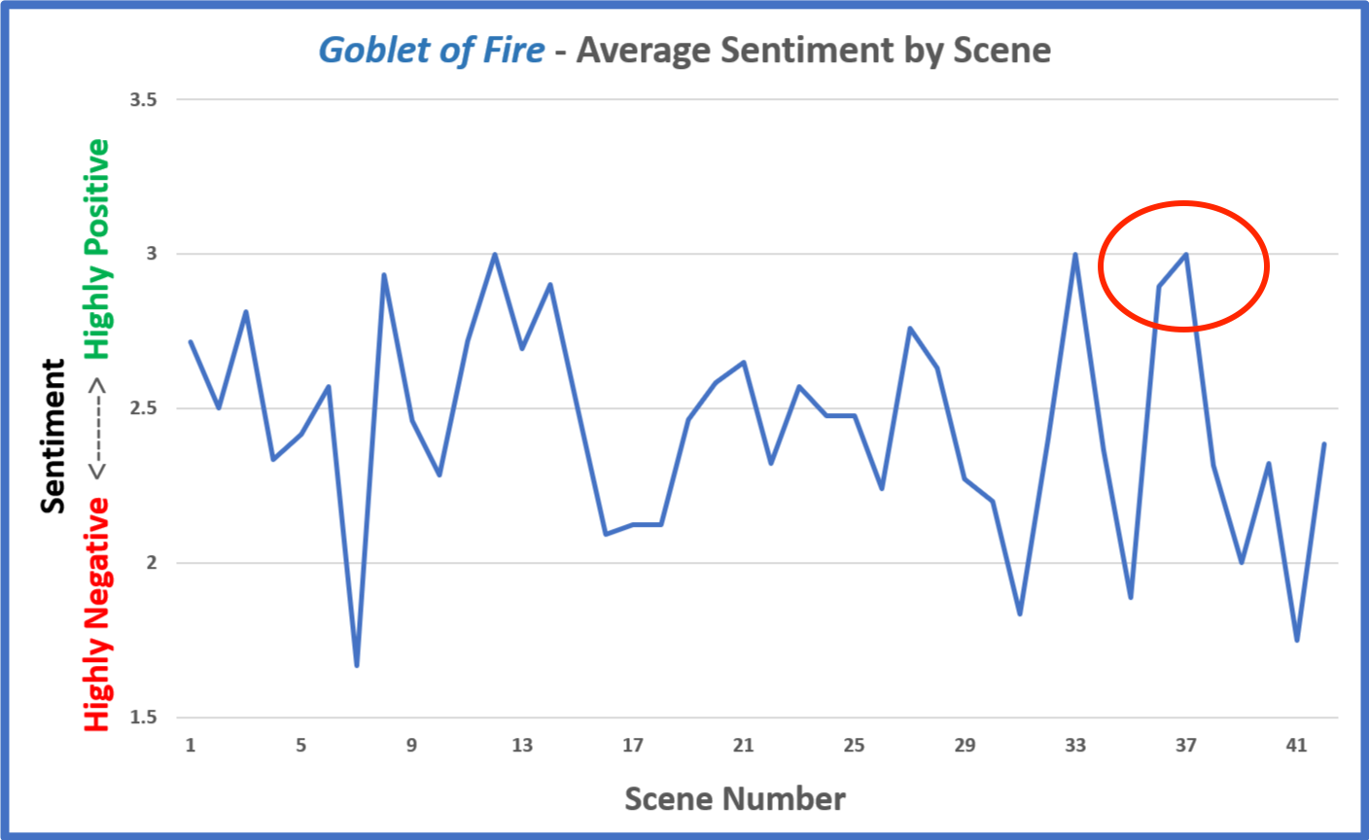
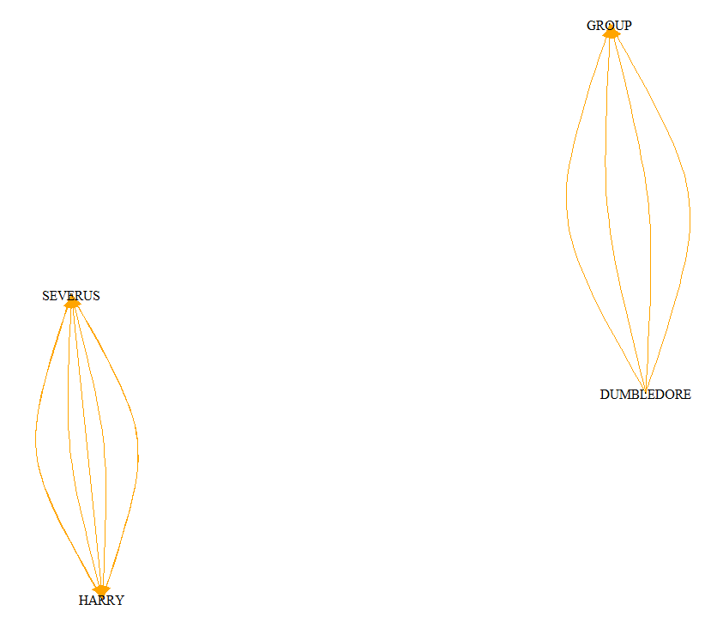
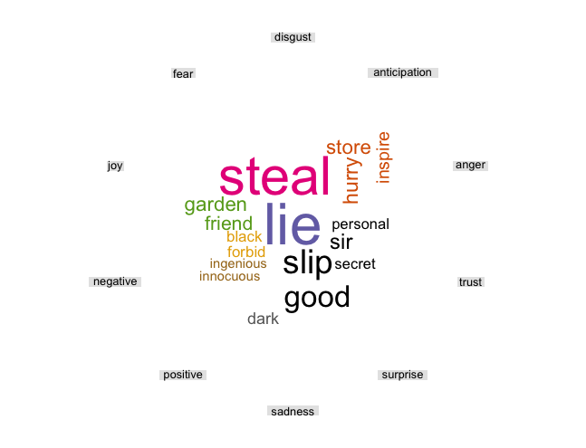
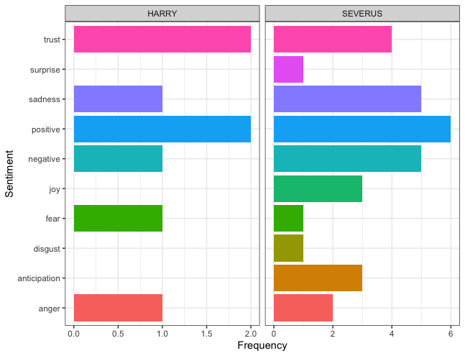

Slide 14
1. Business Case 2. Methodology 3. Findings and Insights 4. Model Refinement
Notes:
By combining our analysis, we propose a predictive model that can predict the score of the movie

Slide 15
Fiction Movie Rating Predictive Model
Script Analysis
Score
Actors
Book Adaptation
Special Effect
Production Budget
& Marketing
Character Diversity
Lexical Complexity
Plot Volatility
Notes:
Hao then Russell - Based on what we had, we developed a predictive model after analyzing our movie script & critic reviews. We found that the factors on the left are the key factors relate to the final movie score. We consider factors in the blue boxes, actors, book adaptation, special effect and production budget & marketing, are external factors that are not related to the script. However, a movie starts from a script so if we can analyze script in an efficient and accurate way it will help movie producer to produce a better movie. Within the script analysis, we define three elements that relate to the script score, we use sentiment analysis for character diversity and plot volatility, then we use text analysis for lexical complexity.

Slide 16
Fiction Movie Rating Predictive Model
Character Diversity (Polarity = .15)
Difference of negative to positive sentiment of main protagonists and antagonists
Script Analysis
Plot Volatility (µ = 2.46, σ = 1.21)
Dynamic measure of emotional complexity
Lexical Complexity (SMOG = 4.9)
SMOG = Simple Measure of Gobbledygook
How advanced is script
Notes:
Hao then Russell

Slide 17
QUESTIONS
Notes:
Russell then everybody

